Slide 1
Unit No. 4 Memory Management

Slide 2
Memory Partitioning
FIXED | DYNAMIC
STATIC The memory is divided into fixed-size partitions or regions, each assigned to a specific process or user. Each partition remains dedicated to a specific process until it terminates or releases the partition. Advantages: Simplicity: Easy to implement. Predictability: Ensures a minimum amount of memory for each process. Security and Stability: Prevents processes from interfering with each other’s memory space. Disadvantages: Internal Fragmentation: Unused memory within a partition. Limited Concurrency: Each process requires a dedicated partition. Used in Real-time systems | VARIABLE In variable partitioning, the main memory is not divided into fixed-sized partitions. Processes are allocated chunks of free memory that are big enough to fit them. Leftover space becomes free memory for other processes. Provides the concept of compaction, where free and unallocated spaces are combined to create a single large memory space. Advantages: Efficient Use of Memory: No fixed-size constraints. Higher Concurrency: Processes share available memory dynamically. Disadvantage: External Fragmentation: Unallocated memory gaps.

Slide 3
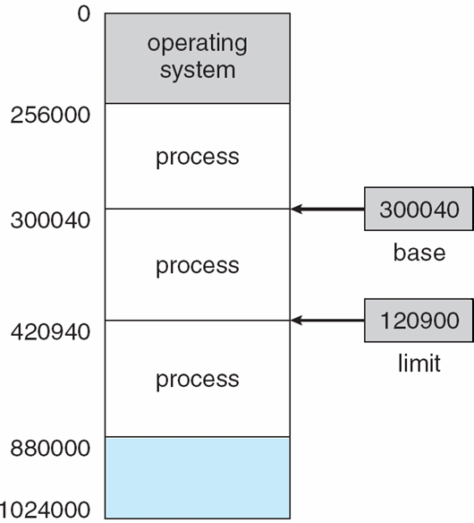
Base and Limit Registers
A pair of base and limit registers define the logical address space
CPU must check every memory access generated in user mode to be sure it is between base and limit for that user

Slide 4
Swapping
A process can be swapped temporarily out of memory to a backing store, and then brought back into memory for continued execution
Total physical memory space of processes can exceed physical memory
System maintains a ready queue of ready-to-run processes which have memory images on disk
Backing store – fast disk large enough to accommodate copies of all memory images for all users; must provide direct access to these memory images
Roll out, roll in – swapping variant used for priority-based scheduling algorithms; lower-priority process is swapped out so higher-priority process can be loaded and executed
Major part of swap time is transfer time; total transfer time is directly proportional to the amount of memory swapped

Slide 5
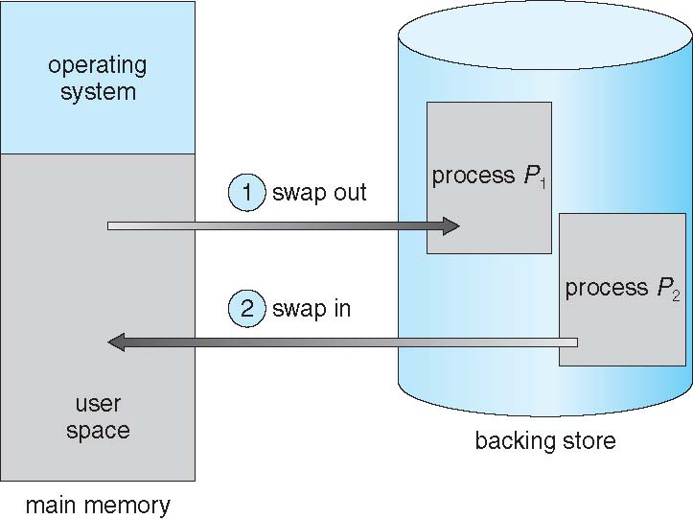
Schematic View of Swapping

Slide 6
Context Switch Time including Swapping
If next processes to be put on CPU is not in memory, need to swap out a process and swap in target process
Context switch time can then be very high
System calls to inform OS of memory use via request_memory() and release_memory()

Slide 7
Context Switch Time and Swapping (Cont.)
Other constraints as well on swapping
Pending I/O – can’t swap out as I/O would occur to wrong process
Or always transfer I/O to kernel space, then to I/O device
Known as double buffering, adds overhead
Standard swapping not used in modern operating systems

Slide 8
Swapping on Mobile Systems
Not typically supported
Flash memory based
Small amount of space
Limited number of write cycles
Poor throughput between flash memory and CPU on mobile platform
Instead use other methods to free memory if low
iOS asks apps to voluntarily relinquish allocated memory
Read-only data thrown out and reloaded from flash if needed
Failure to free can result in termination
Android terminates apps if low free memory, but first writes application state to flash for fast restart

Slide 9
Dynamic Storage-Allocation Problem
How to satisfy a request of size n from a list of free holes?
First-fit: Allocate the first hole that is big enough
Best-fit: Allocate the smallest hole that is big enough; must search entire list, unless ordered by size
Produces the smallest leftover hole
Worst-fit: Allocate the largest hole; must also search entire list
Produces the largest leftover hole
First-fit and best-fit better than worst-fit in terms of speed and storage utilization

Slide 10
Fragmentation
External Fragmentation – total memory space exists to satisfy a request, but it is not contiguous
Internal Fragmentation – allocated memory may be slightly larger than requested memory; this size difference is memory internal to a partition, but not being used

Slide 11
Fragmentation (Cont.)
Reduce external fragmentation by compaction
Shuffle memory contents to place all free memory together in one large block
Compaction is possible only if relocation is dynamic, and is done at execution time
I/O problem
Latch job in memory while it is involved in I/O
Do I/O only into OS buffers

Slide 12
Segmentation
Memory-management scheme that supports user view of memory
A program is a collection of segments
A segment is a logical unit such as:
main program
procedure
function
method
object
local variables, global variables
common block
stack
symbol table
arrays

Slide 13
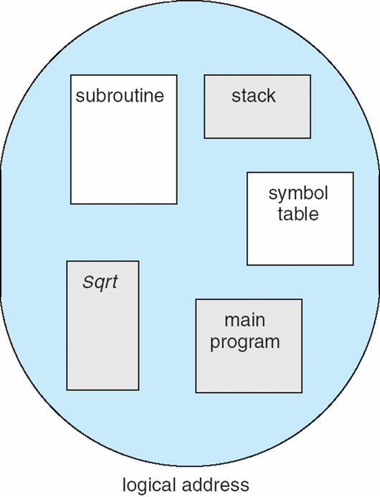
User’s View of a Program

Slide 14
Logical View of Segmentation
1
1
4
2
3
4
2
3
user space
physical memory space

Slide 15
Segmentation Architecture
Logical address consists of a two tuple:
<segment-number, offset>,
Segment table – maps two-dimensional physical addresses; each table entry has:
base – contains the starting physical address where the segments reside in memory
limit – specifies the length of the segment
Segment-table base register (STBR) points to the segment table’s location in memory
Segment-table length register (STLR) indicates number of segments used by a program;
segment number s is legal if s < STLR

Slide 16
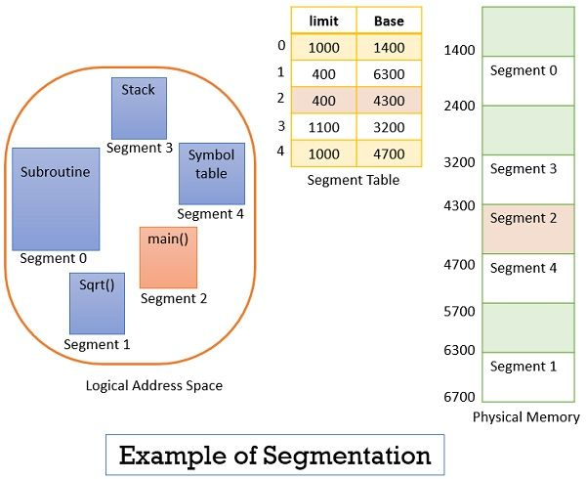
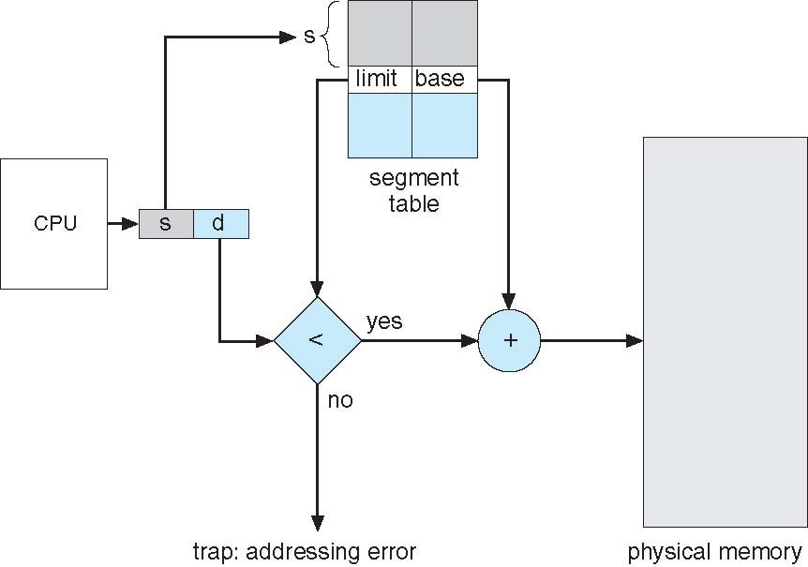
Segmentation Hardware

Slide 17
Paging
The physical address space of a process can be noncontiguous; the process is allocated physical memory whenever the latter is available
Avoids external fragmentation
Avoids the problem of varying-sized memory chunks
Divide physical memory into fixed-sized blocks called frames
Size is power of 2, between 512 bytes and 16 Mbytes
Divide logical memory into blocks of the same size called pages
Keep track of all free frames
To run a program of size N pages, need to find N free frames and load the program
Set up a page table to translate logical to physical addresses
Backing store likewise split into pages
Still have Internal fragmentation

Slide 18
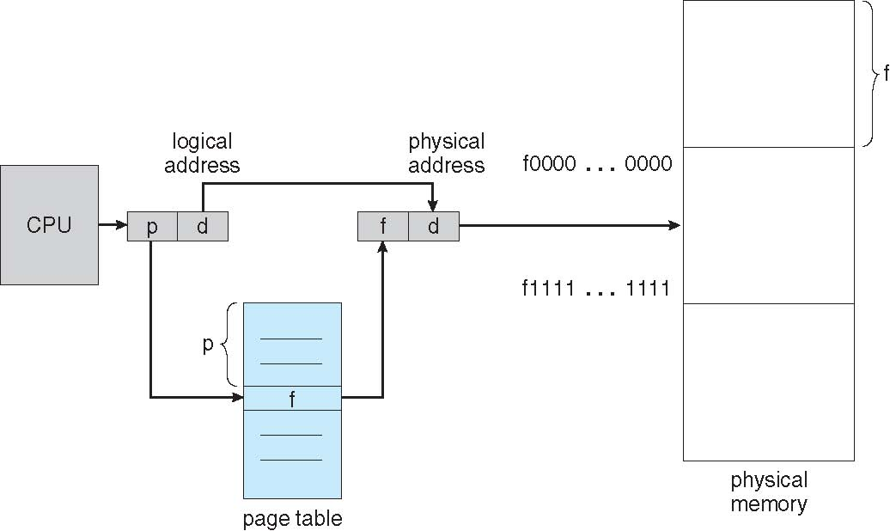
Paging Hardware

Slide 19
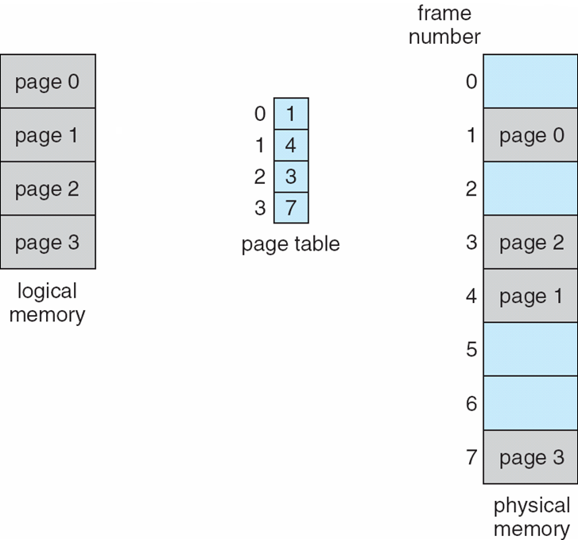
Paging Model of Logical and Physical Memory

Slide 20
Implementation of Page Table
Page table is kept in main memory
Page-table base register (PTBR) points to the page table
Page-table length register (PTLR) indicates size of the page table
In this scheme every data/instruction access requires two memory accesses
One for the page table and one for the data / instruction
The two memory access problem can be solved by the use of a special fast-lookup hardware cache called associative memory or translation look-aside buffers (TLBs)

Slide 21
Implementation of Page Table (Cont.)
Some TLBs store address-space identifiers (ASIDs) in each TLB entry – uniquely identifies each process to provide address-space protection for that process
Otherwise need to flush at every context switch
TLBs typically small (64 to 1,024 entries)
On a TLB miss, value is loaded into the TLB for faster access next time
Replacement policies must be considered
Some entries can be wired down for permanent fast access

Slide 22
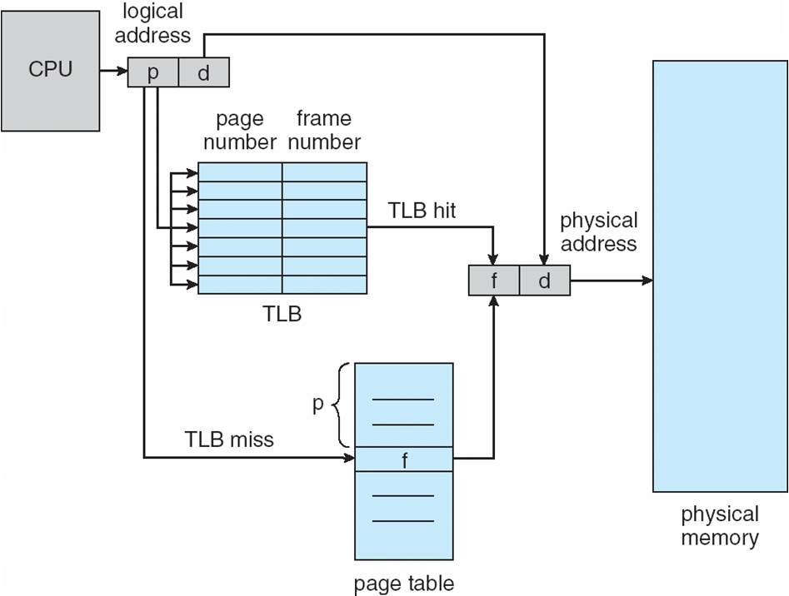
Paging Hardware With TLB

Slide 23
Structure of the Page Table
Memory structures for paging can get huge using straight-forward methods
Consider a 32-bit logical address space as on modern computers
Page size of 4 KB (2¹²)
Page table would have 1 million entries (2³² / 2¹²)
If each entry is 4 bytes -> 4 MB of physical address space/memory for the page table alone
That amount of memory used to cost a lot
Don’t want to allocate that contiguously in main memory
Hierarchical Paging
Hashed Page Tables
Inverted Page Tables

Slide 24
Hierarchical Page Tables
Break up the logical address space into multiple page tables
A simple technique is a two-level page table
We then page the page table

Slide 25
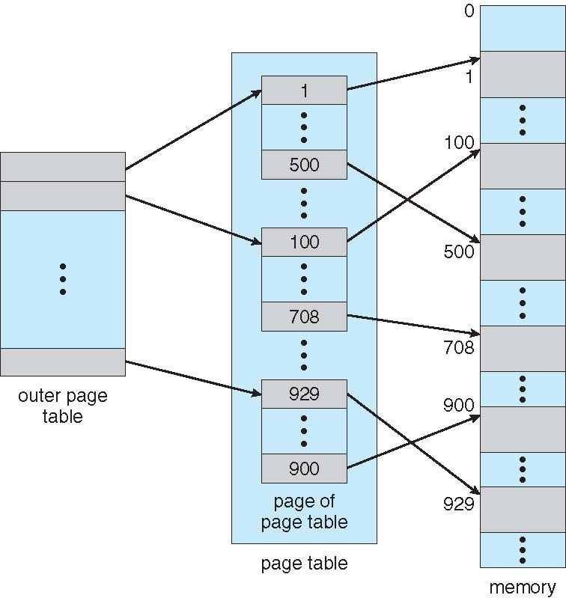
Two-Level Page-Table Scheme

Slide 26
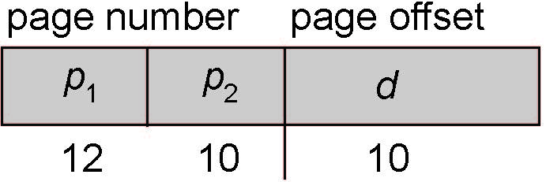
Two-Level Paging Example
A logical address (on 32-bit machine with 1K page size) is divided into:
a page number consisting of 22 bits
a page offset consisting of 10 bits
Since the page table is paged, the page number is further divided into:
a 12-bit page number
a 10-bit page offset
Thus, a logical address is as follows:
where p₁ is an index into the outer page table, and p₂ is the displacement within the page of the inner page table
Known as forward-mapped page table

Slide 27
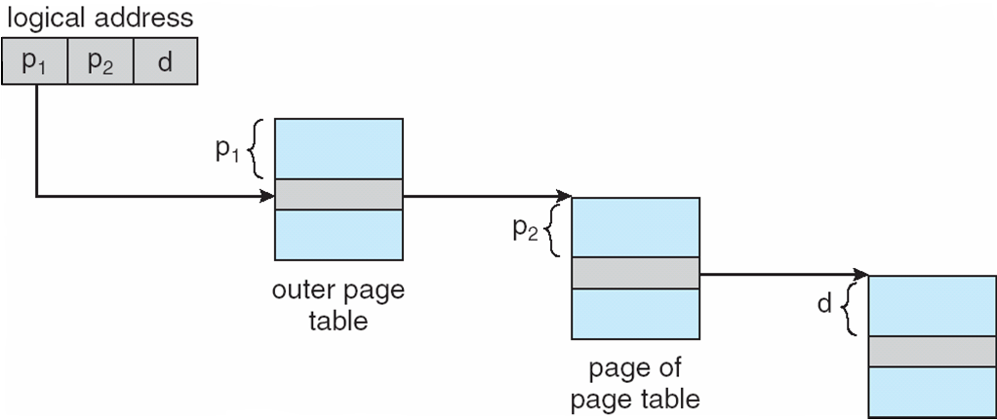
Address-Translation Scheme

Slide 28
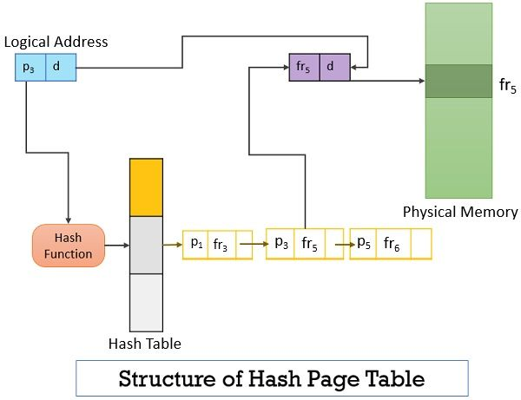
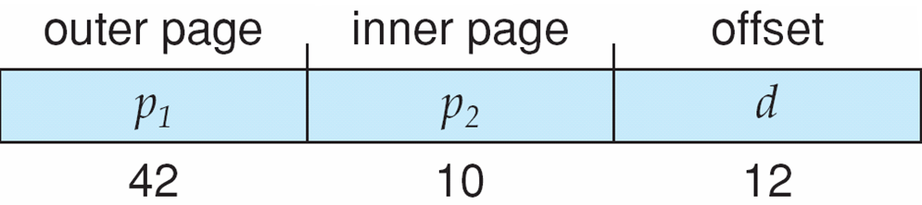
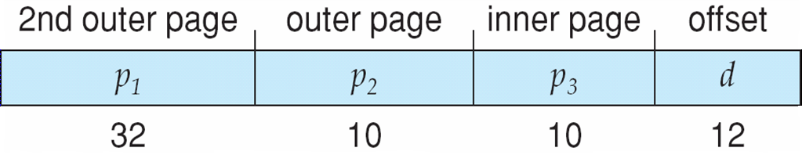
Three-level Paging Scheme

Slide 30
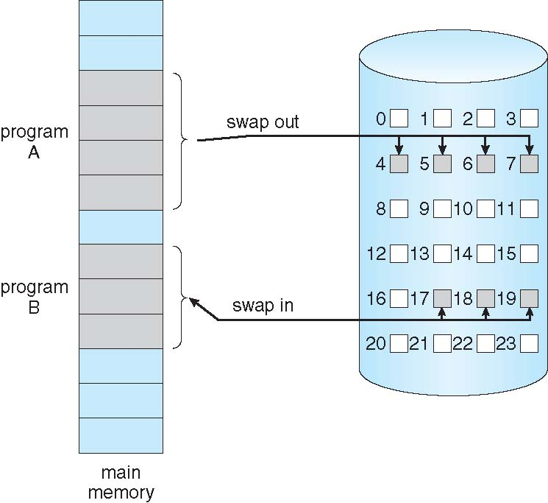
Demand Paging
Could bring entire process into memory at load time
Or bring a page into memory only when it is needed
Less I/O needed, no unnecessary I/O
Less memory needed
Faster response
More users
Similar to paging system with swapping (diagram on right)
Page is needed ⇒ reference to it
invalid reference ⇒ abort
not-in-memory ⇒ bring to memory
Lazy swapper – never swaps a page into memory unless page will be needed
Swapper that deals with pages is a pager

Slide 31
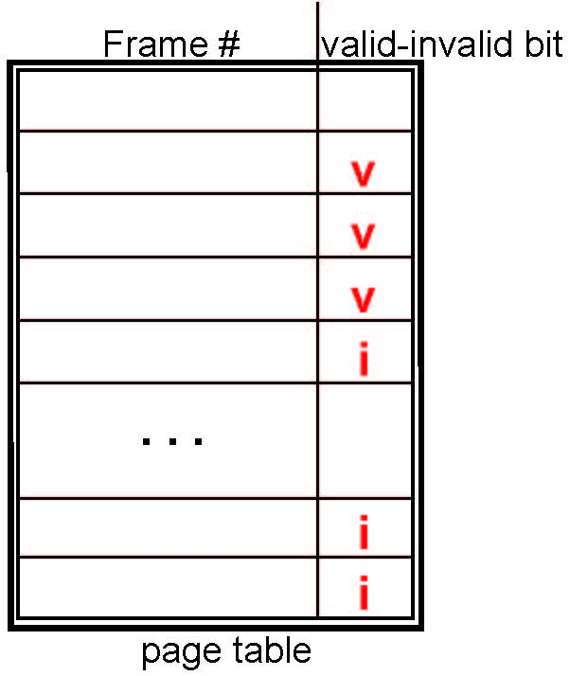
Valid-Invalid Bit
With each page table entry a valid–invalid bit is associated (v ⇒ in-memory – memory resident, i ⇒ not-in-memory)
Initially valid–invalid bit is set to i on all entries
Example of a page table snapshot:
During MMU address translation, if valid–invalid bit in page table entry is i ⇒ page fault

Slide 32
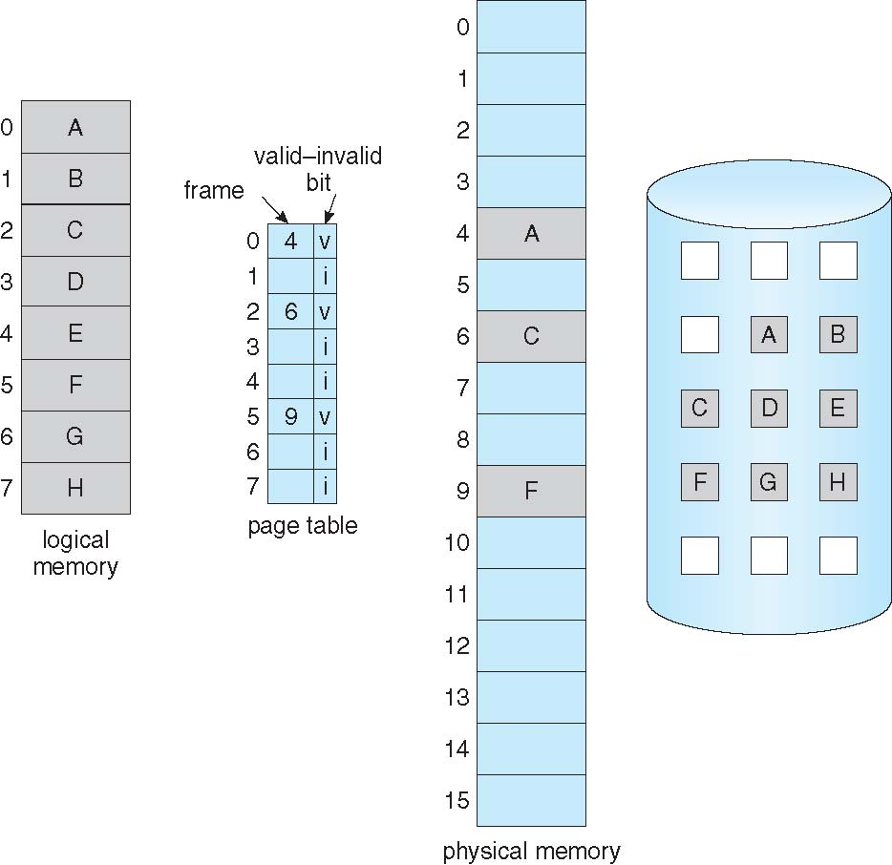
Page Table When Some Pages Are Not in Main Memory

Slide 33
Page Fault
If there is a reference to a page, first reference to that page will trap to operating system:
page fault
Operating system looks at another table to decide:
Invalid reference ⇒ abort
Just not in memory
Find free frame
Swap page into frame via scheduled disk operation
Reset tables to indicate page now in memory Set validation bit = v
Restart the instruction that caused the page fault

Slide 34
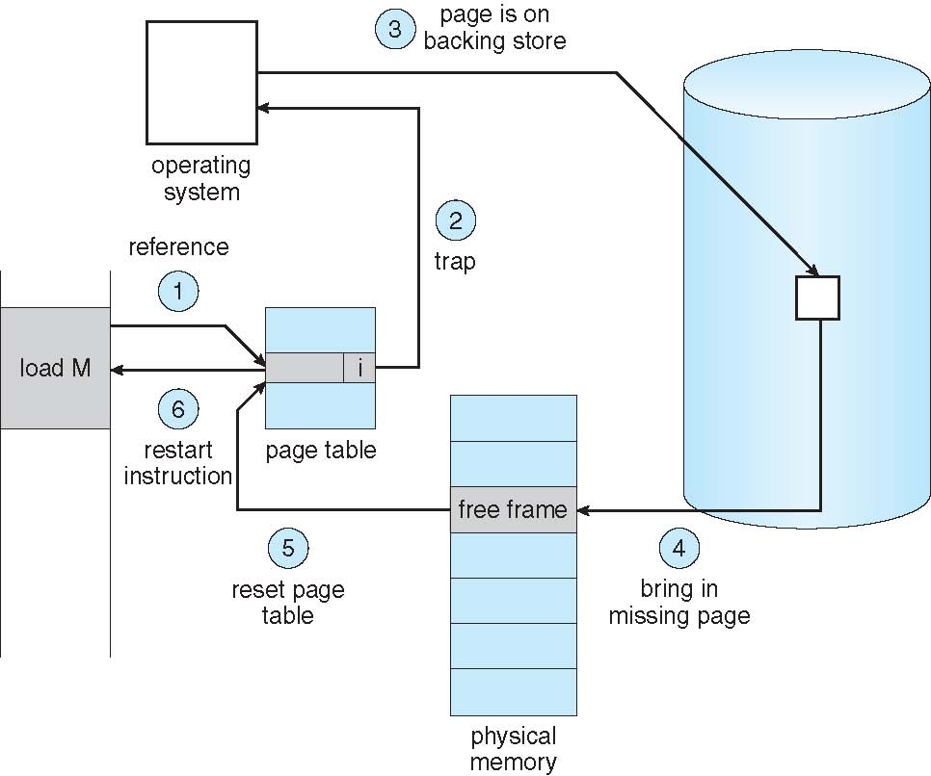
Steps in Handling a Page Fault

Slide 35
Page Replacement
Prevent over-allocation of memory by modifying page-fault service routine to include page replacement
Use modify (dirty) bit to reduce overhead of page transfers – only modified pages are written to disk

Slide 36
Basic Page Replacement
Find the location of the desired page on disk
Find a free frame: - If there is a free frame, use it - If there is no free frame, use a page replacement algorithm to select a victim frame - Write victim frame to disk if dirty
Bring the desired page into the (newly) free frame; update the page and frame tables
Continue the process by restarting the instruction that caused the trap
Note now potentially 2 page transfers for page fault – increasing EAT

Slide 37
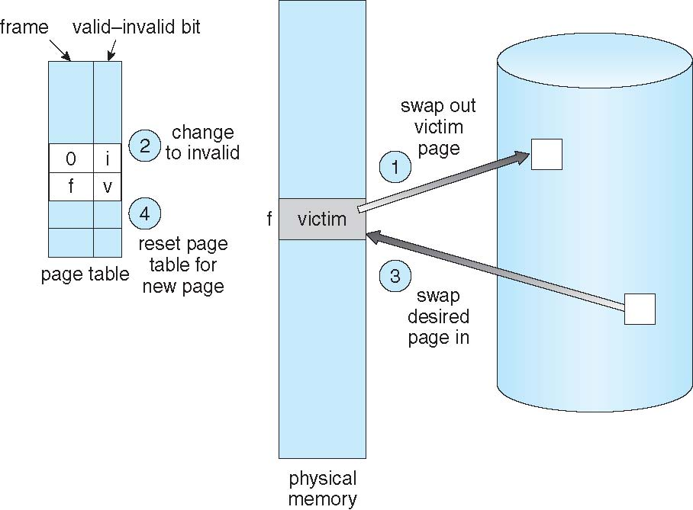
Page Replacement

Slide 38
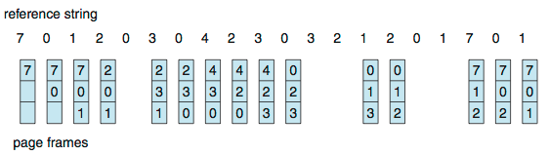
First-In-First-Out (FIFO) Algorithm
Reference string: 7,0,1,2,0,3,0,4,2,3,0,3,0,3,2,1,2,0,1,7,0,1
3 frames (3 pages can be in memory at a time per process)
Can vary by reference string: consider 1,2,3,4,1,2,5,1,2,3,4,5
Adding more frames can cause more page faults!
Belady’s Anomaly
How to track ages of pages?
Just use a FIFO queue
15 page faults

Slide 39
FIFO Illustrating Belady’s Anomaly

Slide 40
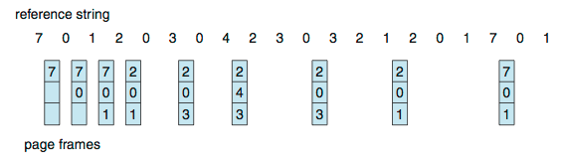
Optimal Algorithm
Replace page that will not be used for longest period of time
9 is optimal for the example
How do you know this?
Can’t read the future
Used for measuring how well your algorithm performs

Slide 41
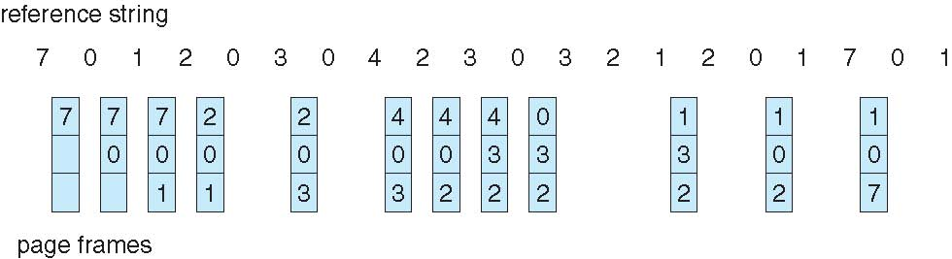
Least Recently Used (LRU) Algorithm
Use past knowledge rather than future
Replace page that has not been used in the most amount of time
Associate time of last use with each page
12 faults – better than FIFO but worse than OPT
Generally good algorithm and frequently used
But how to implement?

Slide 42
LRU Algorithm (Cont.)
Counter implementation
Every page entry has a counter; every time page is referenced through this entry, copy the clock into the counter
When a page needs to be changed, look at the counters to find smallest value
Search through table needed
Stack implementation
Keep a stack of page numbers in a double link form:
Page referenced:
move it to the top
requires 6 pointers to be changed
But each update more expensive
No search for replacement
LRU and OPT are cases of stack algorithms that don’t have Belady’s Anomaly

